Slide 1
Tut 10
Jingyu Li

Slide 2

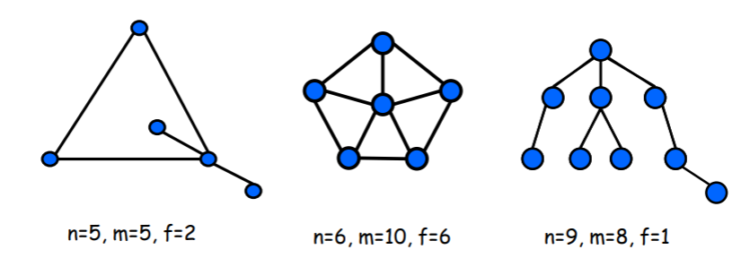


Slide 3
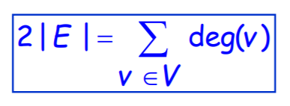
1
Let G be a simple planar graph with at least 3 vertices. Every vertex of G has degree at least five, and at least one vertex of G has degree eight. Show that G has at least fifteen vertices.

Slide 4
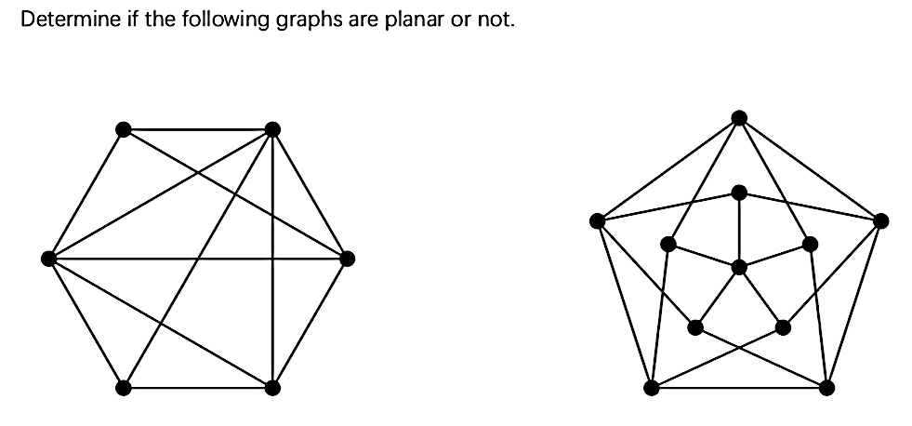

2

Slide 5
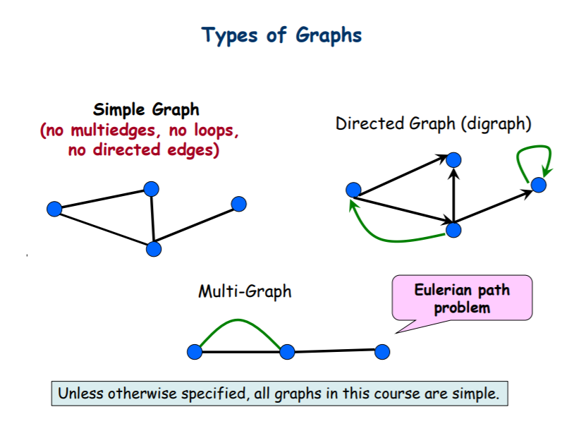

Slide 6
3
Determine whether a graph exists for each of the following degree sequences: 1) 1,2,3,4,5 2) 3,3,3,2,2 3) 4,4,4,4,4 4) 4,4,3,2,1 5) 3,3,2,2,2 If it exists, draw all the possibilities up to isomorphism and determine whether these graphs are planar.

Slide 7
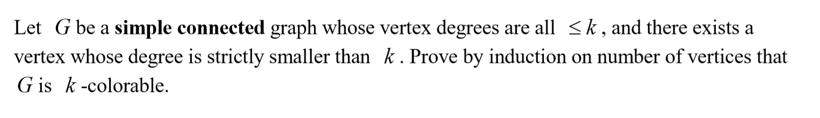
4

